Slide 1

FOR PURPOSES OF FORAGE VIRTUAL WORK EXPERIENCE PROGRAM
WEB SCRAPING TO GAIN COMPANY INSIGHTS
04/06/2023

Slide 2
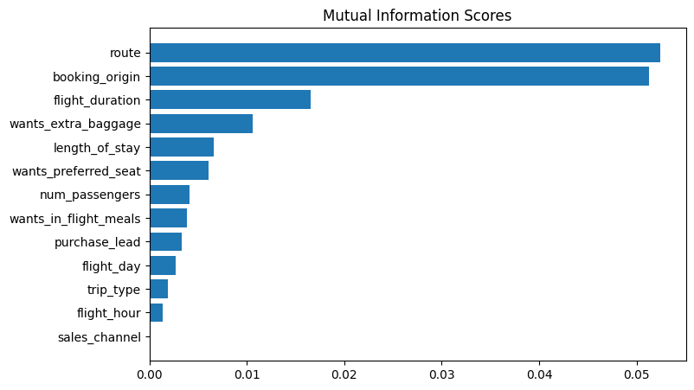
Predictive Model to Understand Factors that Influence Buying Behaviour
We have trained the data set with Random forest classifier model and received
ACCURACY: 85.09
AUC score: 0.558
route
booking_origin
flight_duration
wants_extra_baggage
length_of_stay
are the Top 5 features
which Influence Customer
Buying Behaviour

